Slide 1
Lecture 3
BOOLEAN ALGEBRA
CME 2003
Digital Logic
Şerife SUNGUN

Slide 2
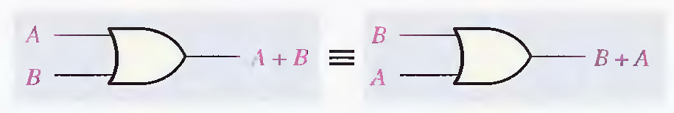
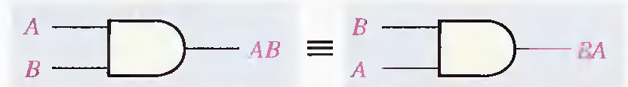
Laws of Boolean Algebra
Commutative Laws :
A+B=B+A
AB = BA
DEU CSE
Şerife SUNGUN

Slide 3
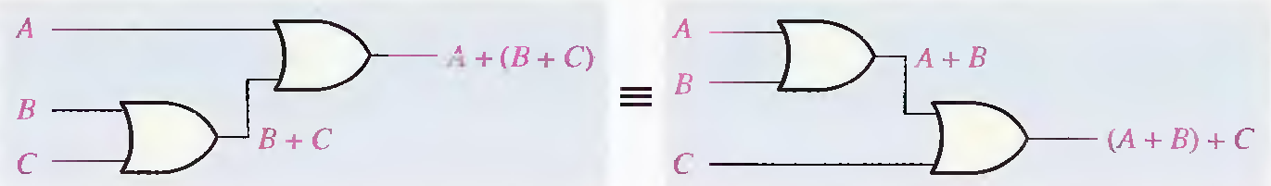
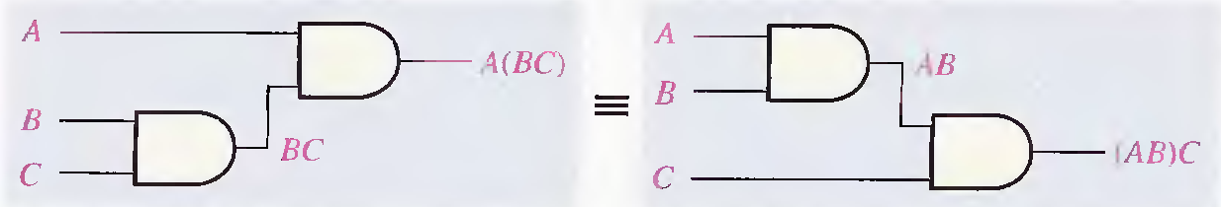
… Laws of Boolean Algebra
Associative Laws:
A + (B + C) = (A + B) + C
A(BC) = (AB)C
DEU CSE
Şerife SUNGUN

Slide 4
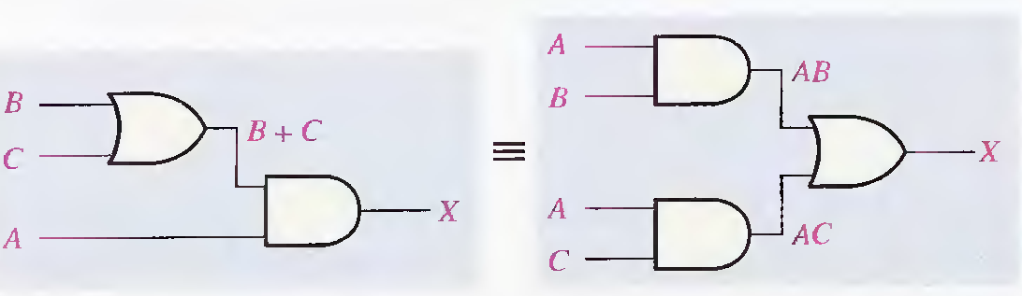
… Laws of Boolean Algebra
Distributive Law :
A(B + C) = AB + AC
AB + C = (A+C)(B+C)
DEU CSE
Şerife SUNGUN

Slide 5
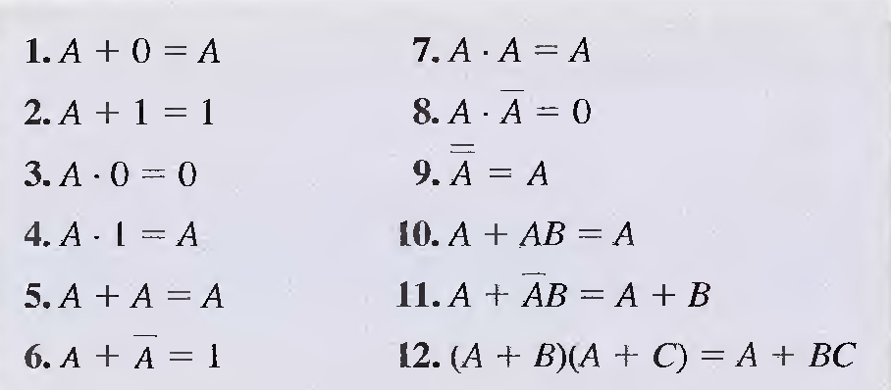
Rules of Boolean Algebra
A, B, C can represent a single variable or a combination of variables.
DEU CSE
Şerife SUNGUN

Slide 6


DEMORGAN'S THEOREMS
The complement of a product of variables is equal to the sum of the complements of the variables,
The complement of a sum of variables is equal to the product of the complements of the variables.
DEU CSE
Şerife SUNGUN

Slide 7
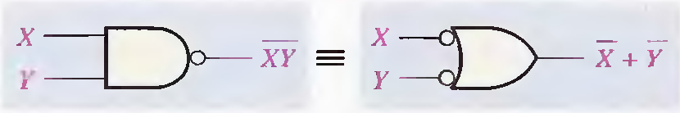
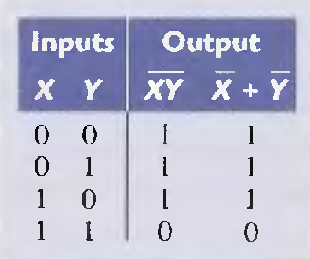
…DEMORGAN'S THEOREMS
DEU CSE
Şerife SUNGUN

Slide 8
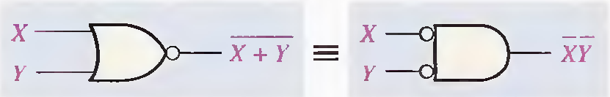
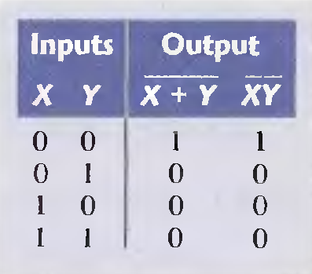
…DEMORGAN'S THEOREMS
DEU CSE
Şerife SUNGUN

Slide 9
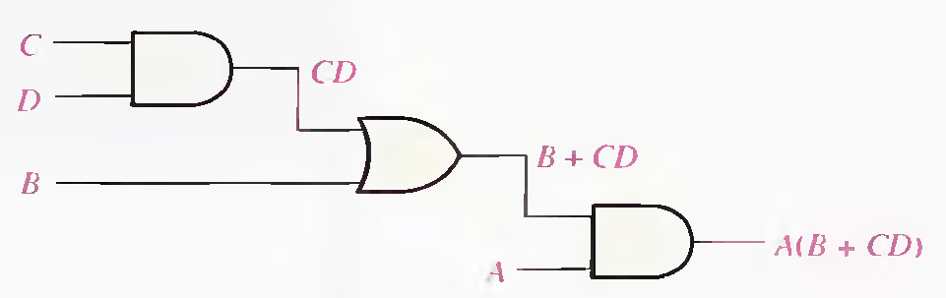
Boolean Expression for a Logic Circuit
DEU CSE
Şerife SUNGUN

Slide 10
Constructing a Truth Table for a Logic Circuit
a truth table that shows the output for all possible values of the input variables can be developed.
DEU CSE
Şerife SUNGUN

Slide 11
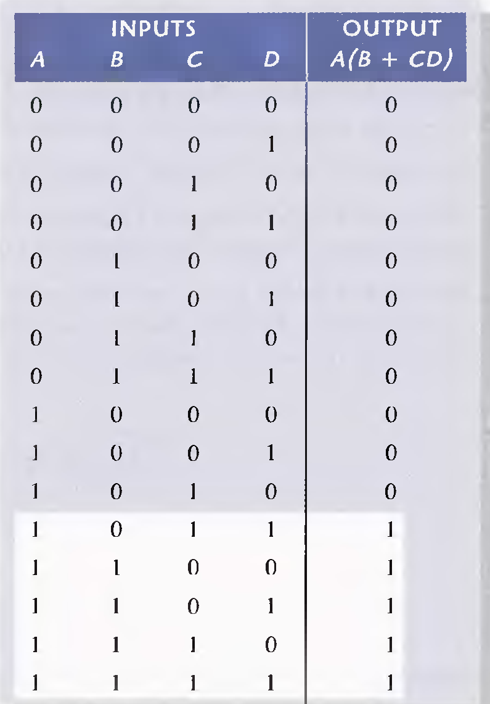
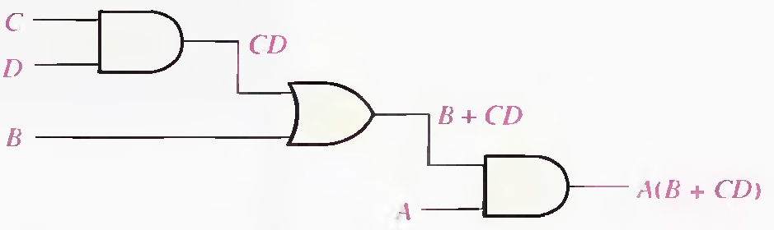
Truth Table
Example:
Boolean Expression:
A(B + CD)
Logic Circuit
DEU CSE
Şerife SUNGUN

Slide 12
SIMPLIFICATION USING BOOLEAN ALGEBRA
to reduce a particular expression to its simplest form or change its form to a more convenient one to implement the expression most
Apply the laws, rules, and theorems of Boolean algebra to simplify general expressions
DEU CSE
Şerife SUNGUN

Slide 13
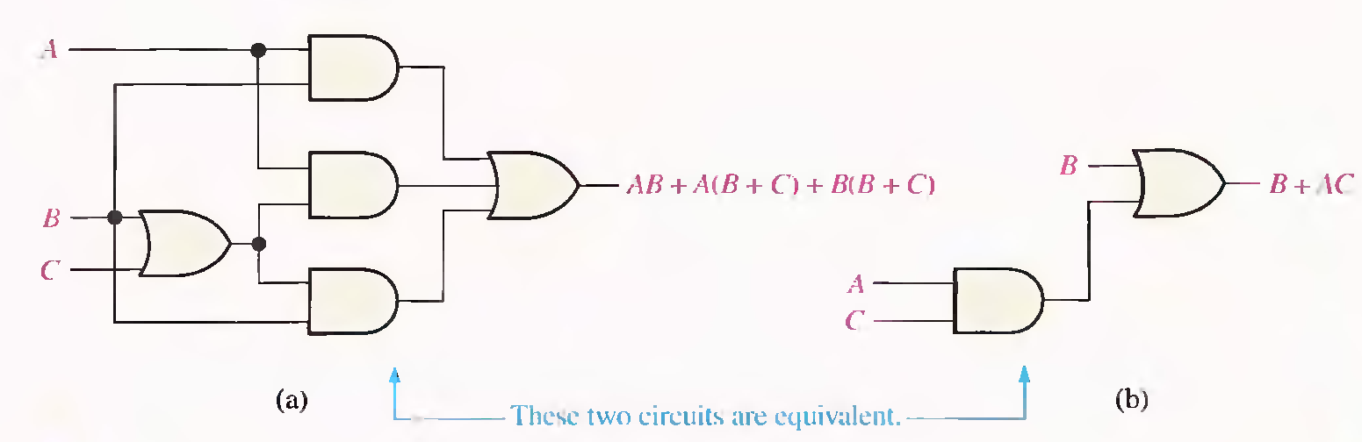
Example
Using Boolean algebra techniques, simplify this expression:
AB + A(B + C) + B(B + C)
  = AB + AB + AC + BB + BC (distributive law )
  = AB + AC + B + BC (rule 7: BB = B ) (rule 5 :AB + AB = AB)
  = AB + AC + B (rule 10: B + BC = B)
  = B + AC (rule 10: AB + B = B)
DEU CSE
Şerife SUNGUN

Slide 14
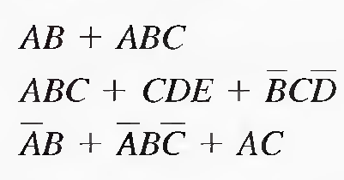
STANDARD FORMS OF BOOLEAN EXPRESSIONS
The Sum-of-Products (SOP) Form
  Example :
DEU CSE
Şerife SUNGUN

Slide 15
AND/OR Implementation of an SOP Expression
Implementing an SOP expression simply requires ORing the outputs of two or more AND gates.
A product term is produced by an AND operation,
the sum (addition) of two or more product terms is produced by an OR operation.
DEU CSE
Şerife SUNGUN

Slide 16
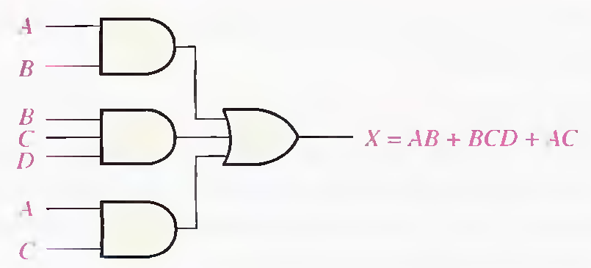
Example
DEU CSE
Şerife SUNGUN

Slide 17

Standard SOP Form
A standard SOP expression is one in which all the variables in the domain appear in each product term in the
Example:
DEU CSE
Şerife SUNGUN

Slide 18
Converting Product Terms to Standard SOP
Step 1. Multiply each nonstandard product term by a term made up of the sum of a missing variable and its complement. This results in two product terms.
Step 2. Repeat Step 1 until all resulting product terms contain all variables in the domain in either complemented or uncomplemented form. In converting a product term to standard form, the number of product terms is doubled for each missing
DEU CSE
Şerife SUNGUN

Slide 19

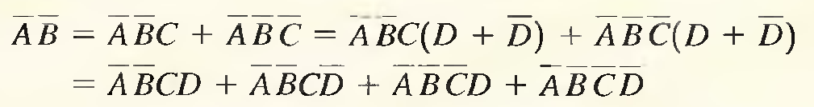
Example
SOP expression:
DEU CSE
Şerife SUNGUN

Slide 20

Binary Representation of a Standard Product Term
A standard product term is equal to 1 for only one combination of variable values.
For example, the product term ABCD is
equal to 1 when A = 1, B = 0, C = 1, D = 0,
DEU CSE
Şerife SUNGUN

Slide 21
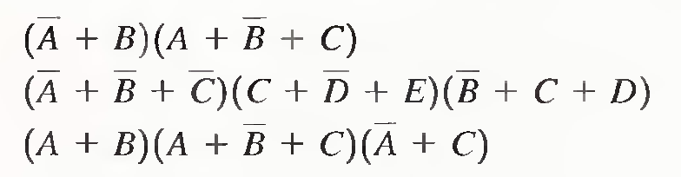
Product-of-Sums (POS) Form
When two or more sum terms are multiplied, the resulting expression is a product-of-sums (POS).
DEU CSE
Şerife SUNGUN

Slide 22
Implementation of a POS Expression
Implementing a pas expression simply requires ANDing the outputs of two or more OR gates.
A sum term is produced by an OR operation.
The product of two or more sum terms is produced by an AND
DEU CSE
Şerife SUNGUN

Slide 23
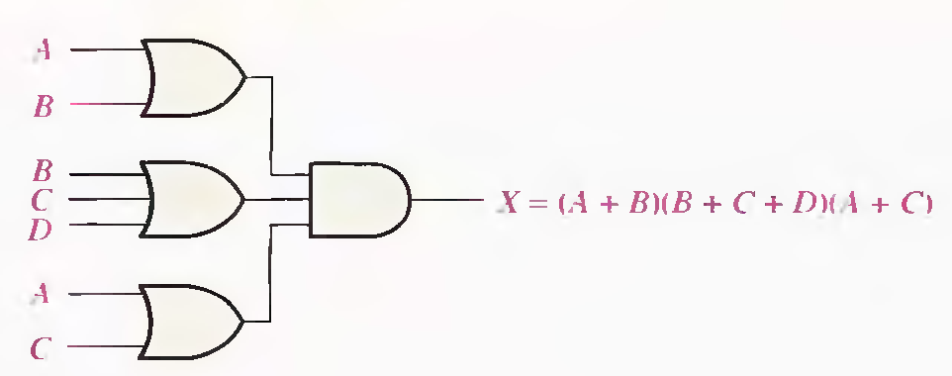
Example
DEU CSE
Şerife SUNGUN

Slide 24
Standard POS Form
all the variables in the domain appear in each sum term in the expression.
Example:
DEU CSE
Şerife SUNGUN

Slide 25
Converting a Sum Term to Standard POS
Step 1. Add to each nonstandard product term a term made up of the product of the missing variable and its complement. This results in two sum terms. As you know, you can add 0 to anything without changing its value.
Step 2. Apply rule 12 from Table 4-1:
A + BC = (A + B)(A + C)
Step 3. Repeat Step 1 until all resulting sum terms contain all variables in the domain in either complemented or uncomplemented form.
DEU CSE
Şerife SUNGUN

Slide 26
Example
DEU CSE
Şerife SUNGUN

Slide 27
Binary Representation of a Standard Sum Term
A standard sum term is equal to 0 for only one combination of variable values.
DEU CSE
Şerife SUNGUN

Slide 28
Converting Standard SOP to Standard POS
Step 1. Evaluate each product term in the SOP expression. That is, determine the binary numbers that represent the product terms.
Step 2. Determine all of the binary numbers not included in the evaluation in Step 1.
Step 3. Write the equivalent sum term for each binary number from Step 2 and express in POS form.
DEU CSE
Şerife SUNGUN

Slide 29


Example
Convert the following SOP expression to an equivalent POS expression:
The evaluation
the POS must contain the other three which are 001,100, and 110.
DEU CSE
Şerife SUNGUN

Slide 30
Converting SOP Expressions to Truth Table Format
an SOP expression is equal to 1 only if at least one of the product terms is equal to 1.
a truth table is simply a list of the possible combinations of input variable values and the corresponding output values (1 or 0).
DEU CSE
Şerife SUNGUN

Slide 31

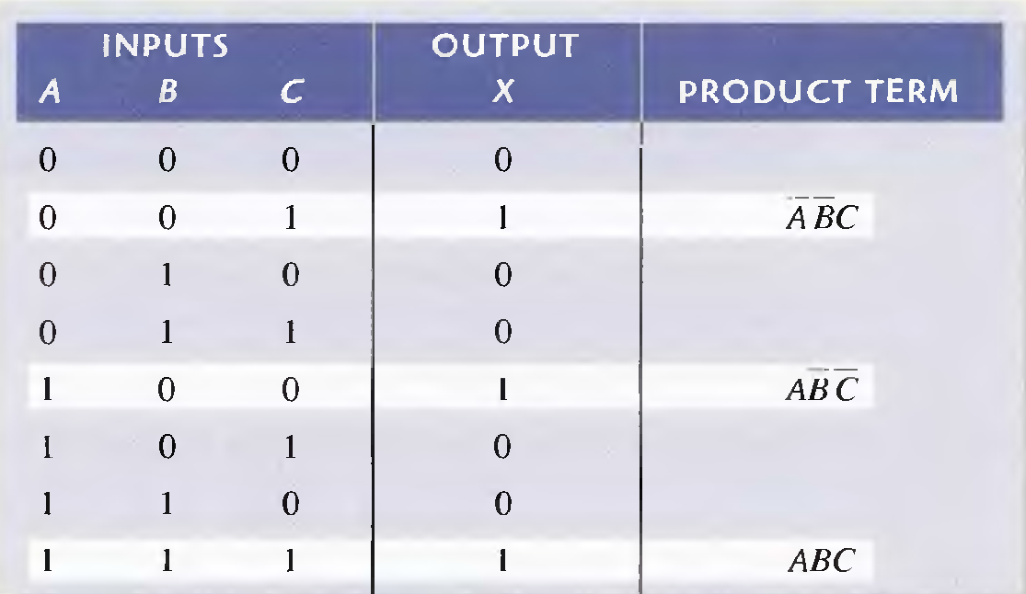
Example
Develop a truth table for the standard SOP expression
DEU CSE
Şerife SUNGUN

Slide 32
Converting POS Expressions to Truth Table Format
Step1 : To construct a truth table from a POS expression, list all the possible combinations of binary values of the variables just as was done for the SOP expression.
Step 2: convert the POS expression to standard form if it is not already.
Step 3: place a 0 in the output column (X) for each binary value that makes the expression a 0 and place a 1 for all the remaining binary values.
DEU CSE
Şerife SUNGUN

Slide 33
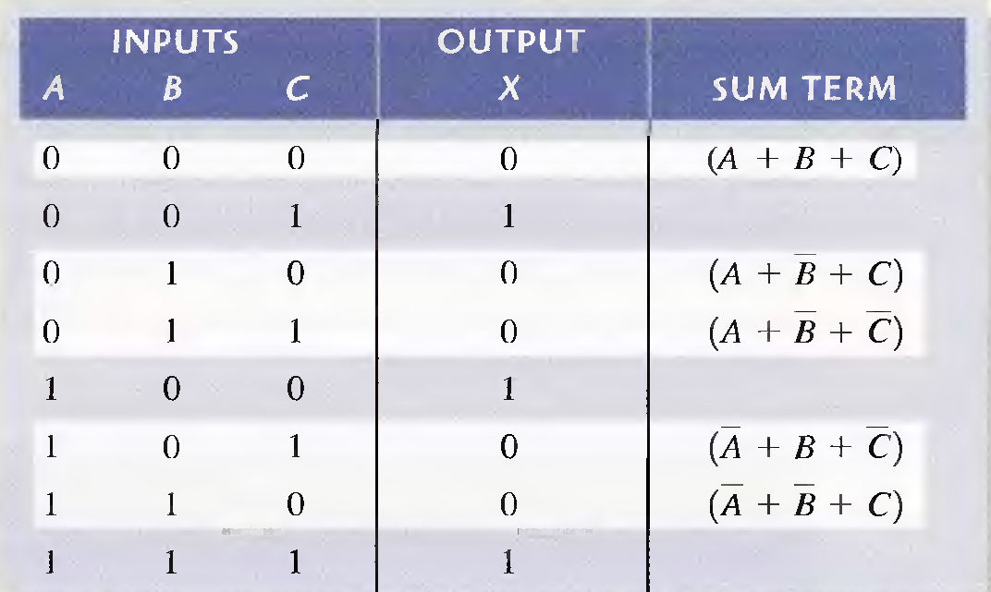
Example
Determine the truth table for the following standard POS expression:
DEU CSE
Şerife SUNGUN

